Slide 1
Distributed Systems Design COMP 6231
Introduction
Lecture 1
Essam Mansour

Slide 2


Slide 3

Course Staff
Instructor: Dr. Essam Mansour
- Email: ​essam.mansour@concordia.ca
- Instructor’s Website: ​emansour.com - Office hours: by appointment
You should arrange for a meeting via email
Teaching Assistant:
- Mahmoud Alfadel (​alfadelmahmood@gmail.com​),
- Babita Bashal (​bbtbashal@gmail.com​)
Labs will be online, too, via Zoom.
Essam
Mahmoud
Babita

Slide 4
Teaching Style
I like interaction in class
I like to ask questions
I like to be asked questions
I like to know (and memorize) your names ☺
I like to give practical assignments and projects
I like to learn …

Slide 5
Course Textbook
Textbook:
Distributed Systems, 3rd ed, by Tannenbaum and Van Steen, Prentice Hall 2018
All lectures will be prepared from this book.
The book is available at the moodle.
plus some other material, we may need.

Slide 6
Course Outline
Introduction (today Part 1)
- What, why, why not?
- Basics
Distributed Architectures
Interprocess Communication
RPCs, RMI, message- and stream-oriented communication
Processes and their scheduling
Thread/process scheduling, code/process migration, virtualization
Naming and location management
- Entities, addresses, access points

Slide 7
Course Outline
Canonical problems and solutions
Mutual exclusion, leader election, clock synchronization, …
Resource sharing, replication and consistency
DFS, consistency issues, caching and replication
Fault-tolerance
Security in distributed Systems
Distributed middleware
Advanced topics: web, cloud computing, green computing, big data, multimedia, and mobile systems

Slide 8
Course Grading
Type | # | Weight
Project | 1 | 35%
Exams | 2 | 40%
Assignments | 5 | 25%
Table 1: Breakdown of the main activities involved in the course.

Slide 9
Course Grading
Project: 35% of your final score.
Each team consists of 3 to 4 students.
Each team will learn one of the following systems:
Pregel, GraphLab, PowerGraph, Cassandra, Couchbase, MongoDB, or Elasticsearch. You can propose a parallel system to develop.
Discuss the concepts of distributed systems in the chosen system.
Use a real dataset of at least one GB, the larger the better, and
Demo the capabilities of the chosen system.
The deliverables of the project are:
Demo 20% of the final grade
Presentation 10% of the final grade
Report 5% of the final grade

Slide 10
Course Grading
Assignments:
- 25% towards your final score
- 5 programming assignments
ID | Topic | Weight | Release Date | Due Date
1 | Java | 1% | Mon Jan 18 | Sun Jan 24
2 | Socket | 3% | Mon Jan 25 | Sun Feb 07
3 | RMI | 13% | Mon Feb 08 | Sun Feb 28
4 | MPI | 4% | Mon Mar 08 | Sun Mar 21
5 | Map-Reduce | 4% | Mon Mar 22 | Sun Mar 28

Slide 11

… and now

Slide 12







Data Becoming Critical to Our Lives
Health
Domains of Data
Science
Education
Work
Environment
Finance
… and more
Notes:
Icons

Slide 13
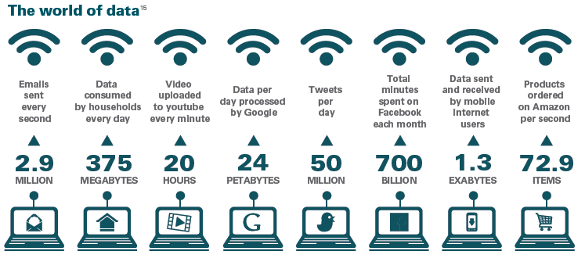
We Live in a World of Data…

Slide 14
What Do We Do With Data?
Store
Access
Encrypt
…. and more!
Process
Share
We want to do these seamlessly...

Slide 15
How to Store and Process Data at Scale?
A system can be scaled:
Either vertically (or up)
Can be achieved by hardware upgrades (e.g., faster CPU, more memory, and/or larger disk)
And/Or horizontally (or out)
Can be achieved by adding more machines

Slide 16
Vertical Scaling
Caveat: Individual computers can still suffer from limited resources with respect to the scale of today’s problems
Caches and Memory:
L1
Cache
L2 Cache
L3 Cache
Main Memory
16-32 KB/Core, 4-5 cycles
128-256 KB/Core, 12-15 cycles
512KB- 2 MB/Core, 30-50 cycles
8GB- 128GB, 300+ cycles

Slide 17
Vertical Scaling
Caveat: Individual computers can still suffer from limited resources with respect to the scale of today’s problems
Processors:
Moore’s law still holds
Chip Multiprocessors (CMPs) are now available
P
P
P
P
P
L1
L1
L1
L1
L1
Interconnect
L2
L2 Cache
A single Processor Chip
A CMP
Notes:
- Moore’s law states that the number of transistors that can be placed in a processor will double approximately every two years, for half the cost.

Slide 18
Vertical Scaling
Caveat: Individual computers can still suffer from limited resources with respect to the scale of today’s problems
Processors:
But up until a few years ago, CPU speed grew at the rate of 55% annually, while the memory speed grew at the rate of only 7%
P
Processor-Memory speed gap
M
Notes:
- Moore’s law states that the number of transistors that can be placed in a processor will double approximately every two years, for half the cost.

Slide 19
Vertical Scaling
Caveat: Individual computers can still suffer from limited resources with respect to the scale of today’s problems
Processors:
But up until a few years ago, CPU speed grew at the rate of 55% annually, while the memory speed grew at the rate of only 7%
Even if 100s or 1000s of cores are placed on a CMP, it is a challenge to deliver input data to these cores fast enough for processing
Notes:
- Moore’s law states that the number of transistors that can be placed in a processor will double approximately every two years, for half the cost.

Slide 20

Vertical Scaling
10000 seconds (or 3 hours) to load data
P
P
P
P
Suffer from
limited scalability
L1
L1
L1
L1
Interconnect
A Data Set
of 4 TBs
L2 Cache
Memory
4 100MB/S IO Channels

Slide 21
How to Store and Process Data at Scale?
A system can be scaled:
Either vertically (or up)
Can be achieved by hardware upgrades (e.g., faster CPU, more memory, and/or larger disk)
And/Or horizontally (or out)
Can be achieved by adding more machines

Slide 22
Horizontal Scaling
Only 3 minutes to load data
P
100
Machines
P
Splits
L1
L1
L2
L2
Memory
Memory
A Data Set (data)
of 4 TBs

Slide 23
Requirements
But, this necessitates:
A way to express the problem in terms of parallel processes and execute them on different machines (Programming and Concurrency Models)
A way to organize processes (Architectures)
A way for distributed processes to exchange information (Communication Paradigms)
A way to locate and share resources (Naming Protocols)
Notes:
- Moore’s law states that the number of transistors that can be placed in a processor will double approximately every two years, for half the cost.

Slide 24
Requirements
But, this necessitates:
A way for distributed processes to cooperate, synchronize with one another, and agree on shared values (Synchronization)
A way to reduce latency, enhance reliability, and improve performance (Caching, Replication, and Consistency)
A way to enhance load scalability, reduce diversity across heterogeneous systems, and provide a high degree of portability and flexibility (Virtualization)
A way to recover from partial failures (Fault Tolerance)
Notes:
- Moore’s law states that the number of transistors that can be placed in a processor will double approximately every two years, for half the cost.

Slide 25
Degree of Parallelism
DATA
D
A
T
A
Task Parallelism
Data Parallelism

Slide 26
So, What is a Distributed System?
A distributed system is:
A collection of independent computers that appear to its users as a single coherent system
One in which components located at networked computers communicate and coordinate their actions only by passing messages

Slide 27
Features
Distributed Systems imply four main features:
1
Geographical Separation
2
No Common Physical Clock
No Common Physical Memory
3
4
Autonomy and Heterogeneity

Slide 28

Parallel vs. Distributed Systems
Distributed systems contrast with parallel systems, which entail:
1
Strong Coupling
2
A Common Physical Clock
I am not sure.
Can you verify that?
A Shared Physical Memory
3
4
Homogeneity

Slide 29
Another Definition of a Distributed System
A distributed system:
- Multiple connected CPUs working together
- A collection of independent computers that appears to its users as a single coherent system
Examples: parallel machines, networked machines

Slide 30
Distributed System Models
Cluster computing systems / Data centers
LAN with a cluster of servers + storage
Linux, Mosix, ..
Used by distributed web servers, scientific applications, enterprise applications
Grid computing systems
Cluster of machines connected over a WAN
SETI @ home
WAN-based clusters / distributed data centers
Google, Amazon, Facebook …
Virtualization and data center
Cloud Computing

Slide 31








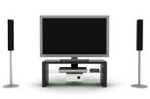

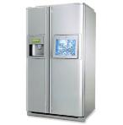
Emerging Models
Distributed Pervasive Systems
“smaller” nodes with networking capabilities
Computing is “everywhere”
Mobile Devices
Computers
…and even appliances
Consumer Electronics
Personal Monitors and Sensors
We also want to access, share and process our data from all of our devices, anytime, anywhere!

Slide 32
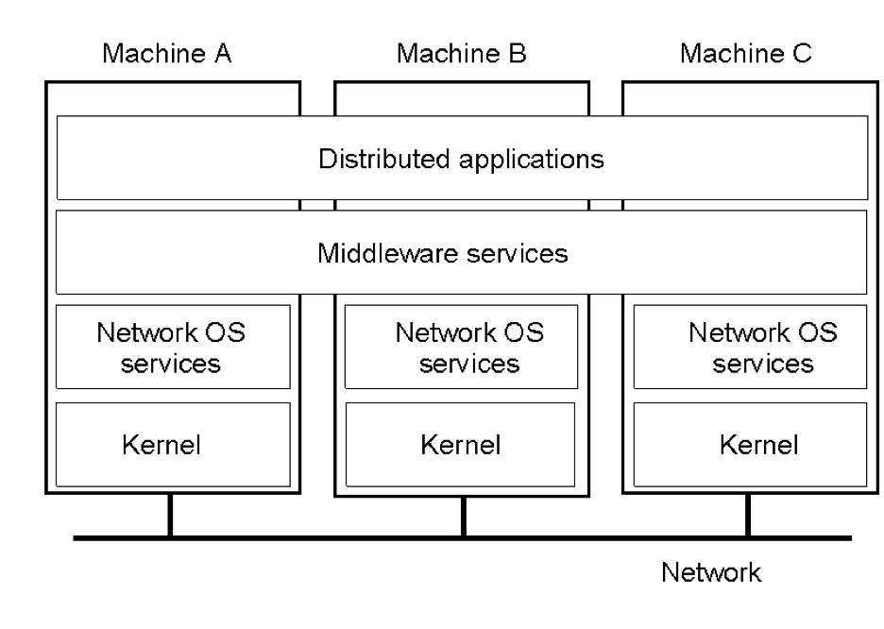
Middleware-based Systems
General structure of a distributed system as middleware.

Slide 33
Transparency in a Distributed System
Transparency | Description
Access | Hide differences in data representation and how a resource is accessed
Location | Hide where a resource is located
Migration | Hide that a resource may move to another location
Relocation | Hide that a resource may be moved to another location while in use
Replication | Hide that a resource may be replicated
Concurrency | Hide that a resource may be shared by several competitive users
Failure | Hide the failure and recovery of a resource
Persistence | Hide whether a (software) resource is in memory or on disk

Slide 34
Scalable Distributed System
Scalability Dimensions
﻿- Size scalability:
A system can be scalable with respect to its size,
we can easily add more users and resources to the system without any noticeable loss of performance.
﻿Geographical scalability:
The users and resources may lie far apart,
The fact that communication delays may be significant is hardly noticed.
﻿Administrative Scalability:
Still be easily managed even if it spans many independent administrative organizations.

Slide 35
Scaling Techniques
Principles for good decentralized algorithms
No machine has complete state
Make decision based on local information
A single failure does not bring down the system
No global clock
Techniques
Asynchronous communication
Distribution
Caching and replication

Slide 36
Comparison between Systems
Item | Distributed OS |  | Network OS | Middleware-based OS
 | Multiproc. | Multicomp.
Degree of transparency | Very High | High | Low | High
Same OS on all nodes | Yes | Yes | No | No
Number of copies of OS | 1 | N | N | N
Basis for communication | Shared memory | Messages | Files | Model specific
Resource management | Global, central | Global, distributed | Per node | Per node
Scalability | No | Moderately | Yes | Varies
Openness | Depends on OS | Depends on OS | Open | Open

Slide 37
A To-Do List
Read Chapters 1, ﻿Introduction
Attend the lab
Start working in your first assignment

Slide 38
Next Lecture
Chapter 2: ﻿Architectures
Monday 11:45 to 2:15
Wed: no live lecture
Questions?

